Slide 2
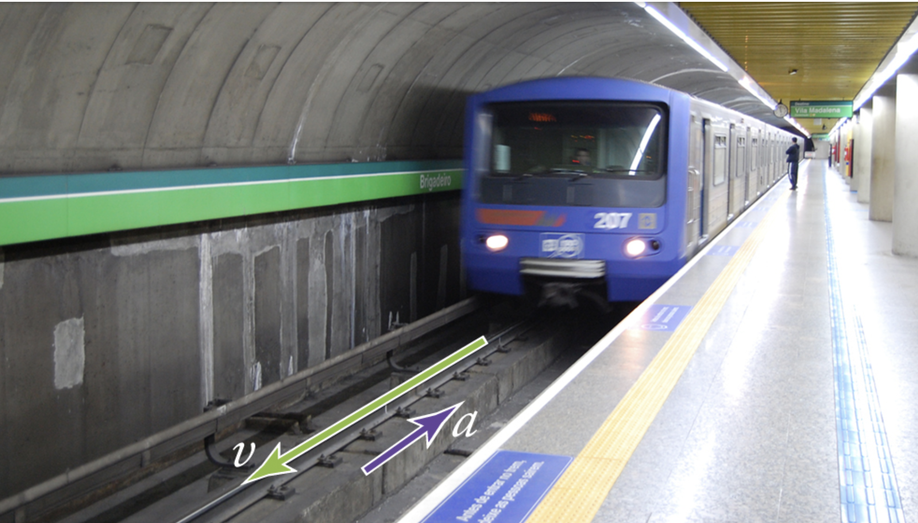
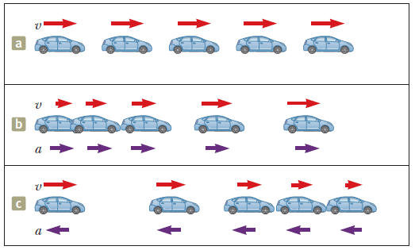
Describing Motion
The main purpose of mechanics is to describe and predict the motion of an object (some objects).
Motion diagrams or verbal descriptions can be used, but the most effective way is by mathematical formulation and equations.
Moving to the right with the same speed of 3 meters per second.
Moving to the right with initial speed of 1 meter per second and increasing its speed at a constant rate of 2 meters per second per second.
Moving to the right with initial speed of 5 meters per second and decreasing its speed at a constant rate of 2 meters per second per second.

Slide 3
Some Physical Vector Quantities for Describing Motion
A physical quantity is a physical property of an object that can be quantified by measurement.
The two common types physical quantities are vectors and scalars.
Usually we denote the physical quantities using symbols with some specified (SI) units.
Physical vector quantities | Unit
Displacement, s | m
Velocity, v | ms⁻¹
Acceleration, a | ms⁻²
In general, a vector quantity requires the specification of both direction and magnitude.
By contrast, a scalar quantity has a numerical value and no direction. For example, distance and speed are scalar quantities.

Slide 4
SI units (International System of Units,Le Système international d'unités)
There are seven base units. They are:
Base Quantity | Name | Symbol
 | SI base units
Length | meter | m
Mass | kilogram | kg
Time | second | s
Thermodynamic Temperature | Kelvin | K
Electric Current | Ampere | A
Luminous Intensity | Candela | cd
Amount of Substance | mole | mol
Section 1.1

Slide 5
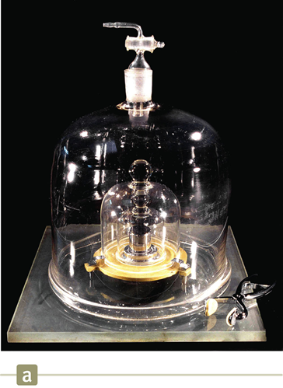
Quantities Used in Mechanics
In mechanics, three fundamental quantities are used:
  Length (SI unit: m) [Historical context of m]
    Defined in terms of a meter – the distance traveled by light in a vacuum during a given time
  Mass (SI unit: kg) [Historical context of kg]
    Defined in terms of a kilogram, based on a specific cylinder kept at the International Bureau of Standards
  Time (SI unit: s) [Historical context of s]
    Defined in terms of the oscillation of radiation from a cesium atom
All other quantities in mechanics can be expressed in terms of the three fundamental quantities.

Slide 6
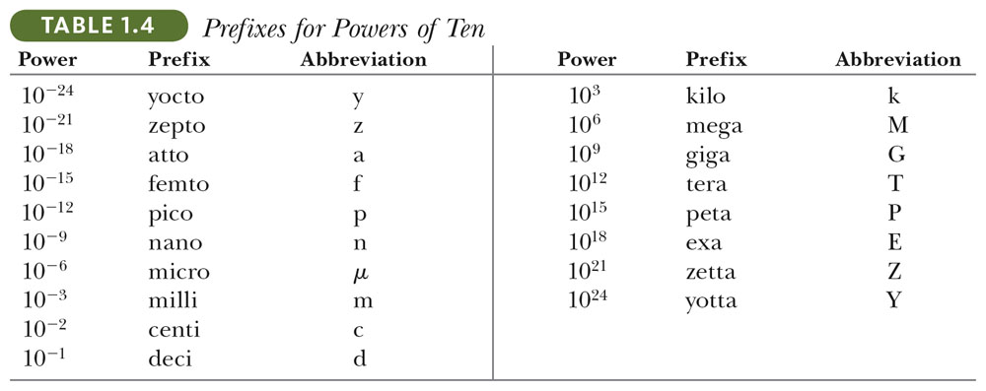
Number Notations: Prefixes
The prefixes can be used with any SI units (with exception of kg, we use g [gram]). For examples:
  1 km = 10³ m; 1 mm = 10⁻³ m; 1 nm = 10⁻⁹ m

Slide 7
Mechanics, the study of motion, has two parts
• Kinematics is the mathematical description of motion. (Our starting point)
• Dynamics is the study of the causes of motion (including forces, energy, etc.)

Slide 8
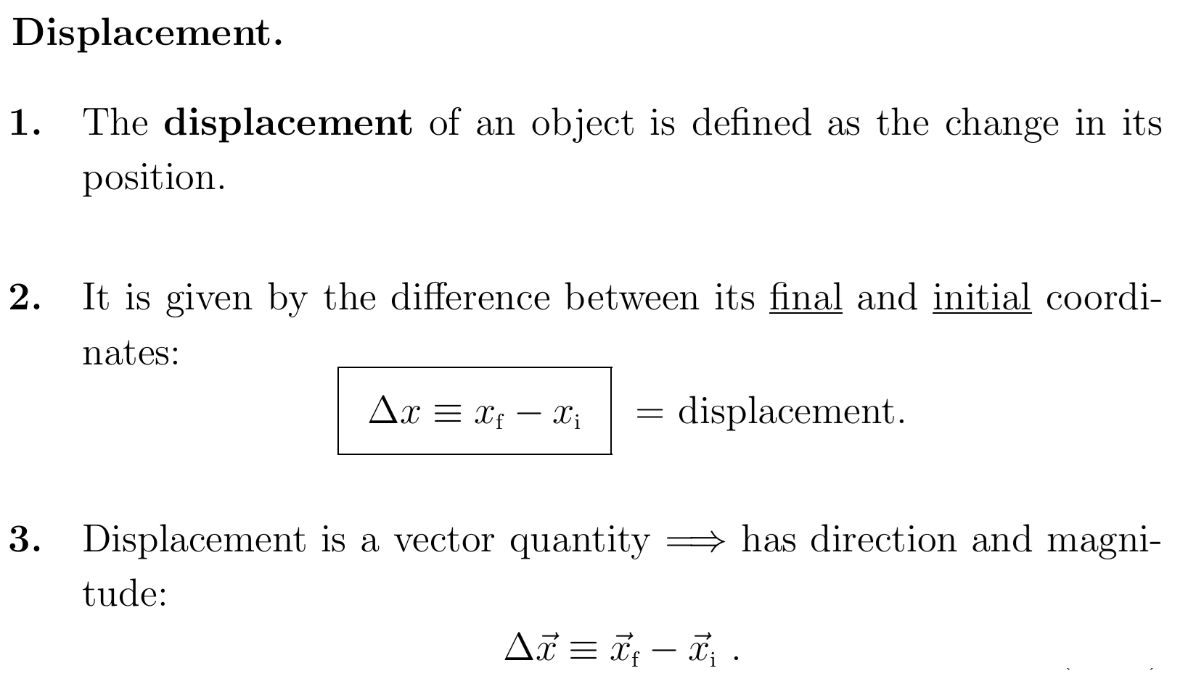

Slide 9
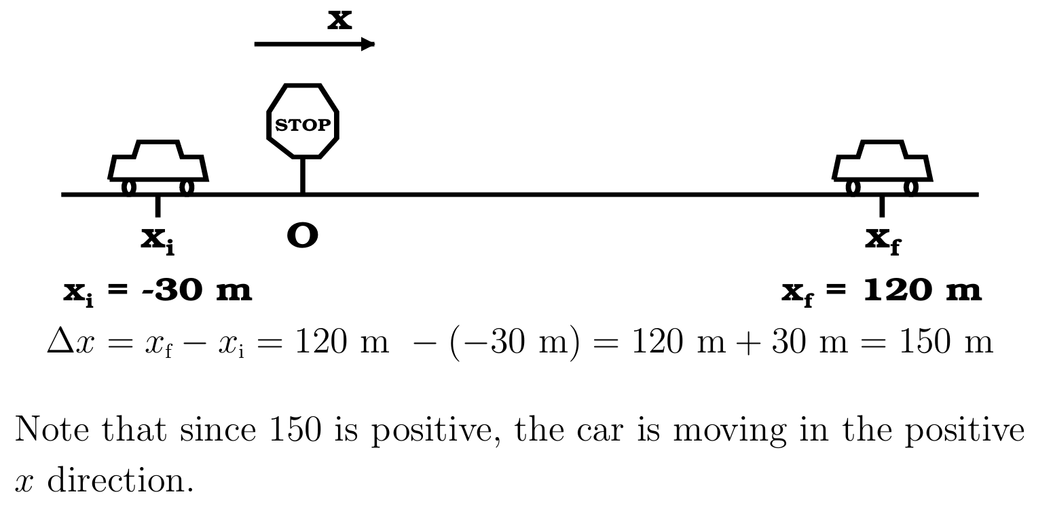
A car starts at a position 30 m from a stop sign and continues past the stop sign until it comes to rest 120 m past the sign. What is its displacement?

Slide 10
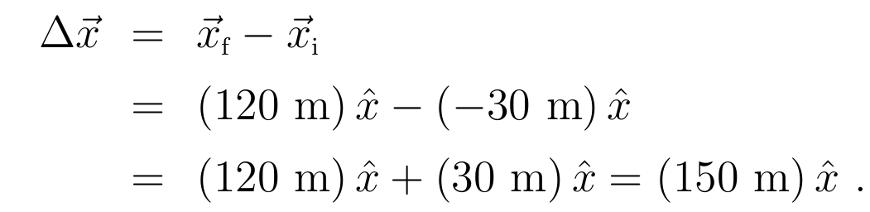
we could have solved the problem us ing vector notation:

Slide 11
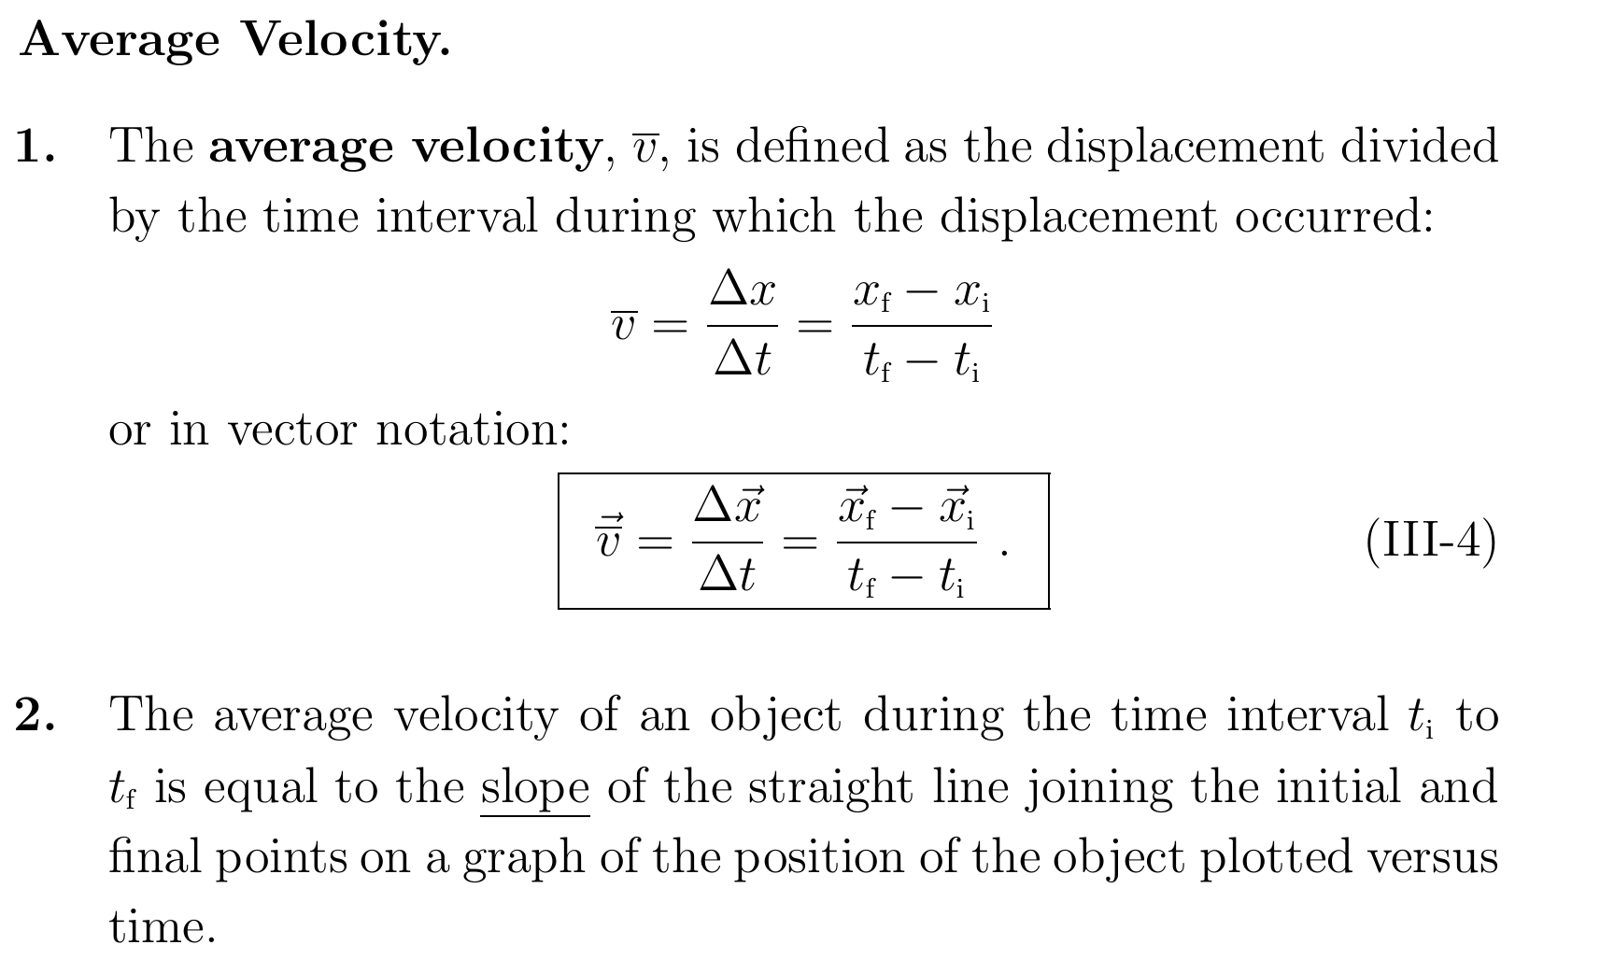

Slide 12
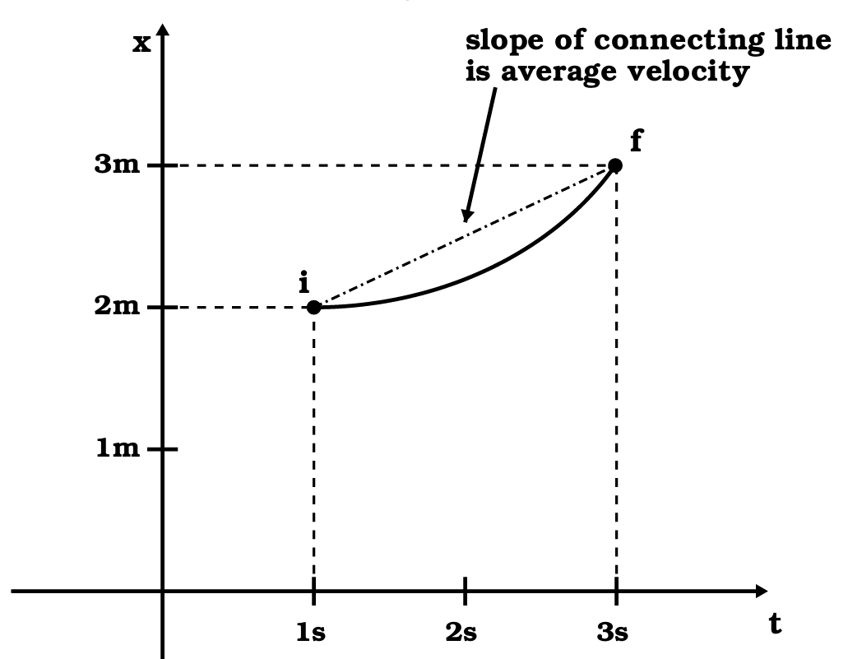
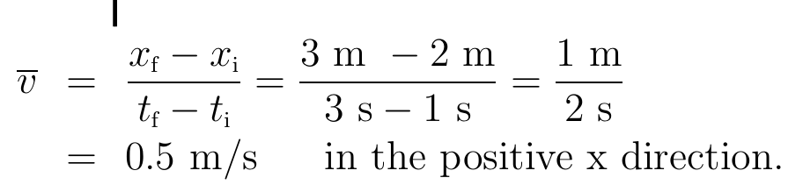
From the graph below, calculate the average velocity of the trajectory plotted.

Slide 13

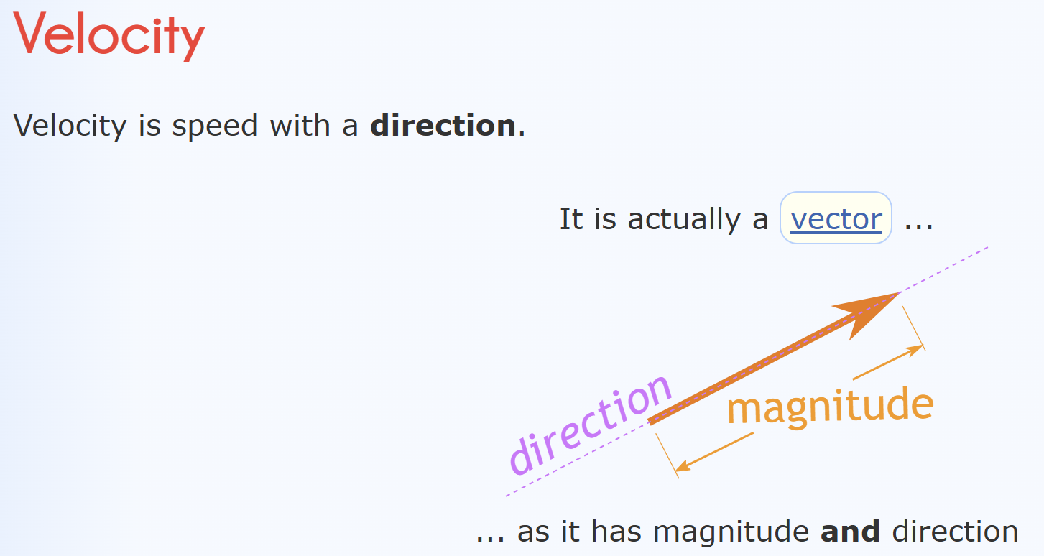

Slide 14
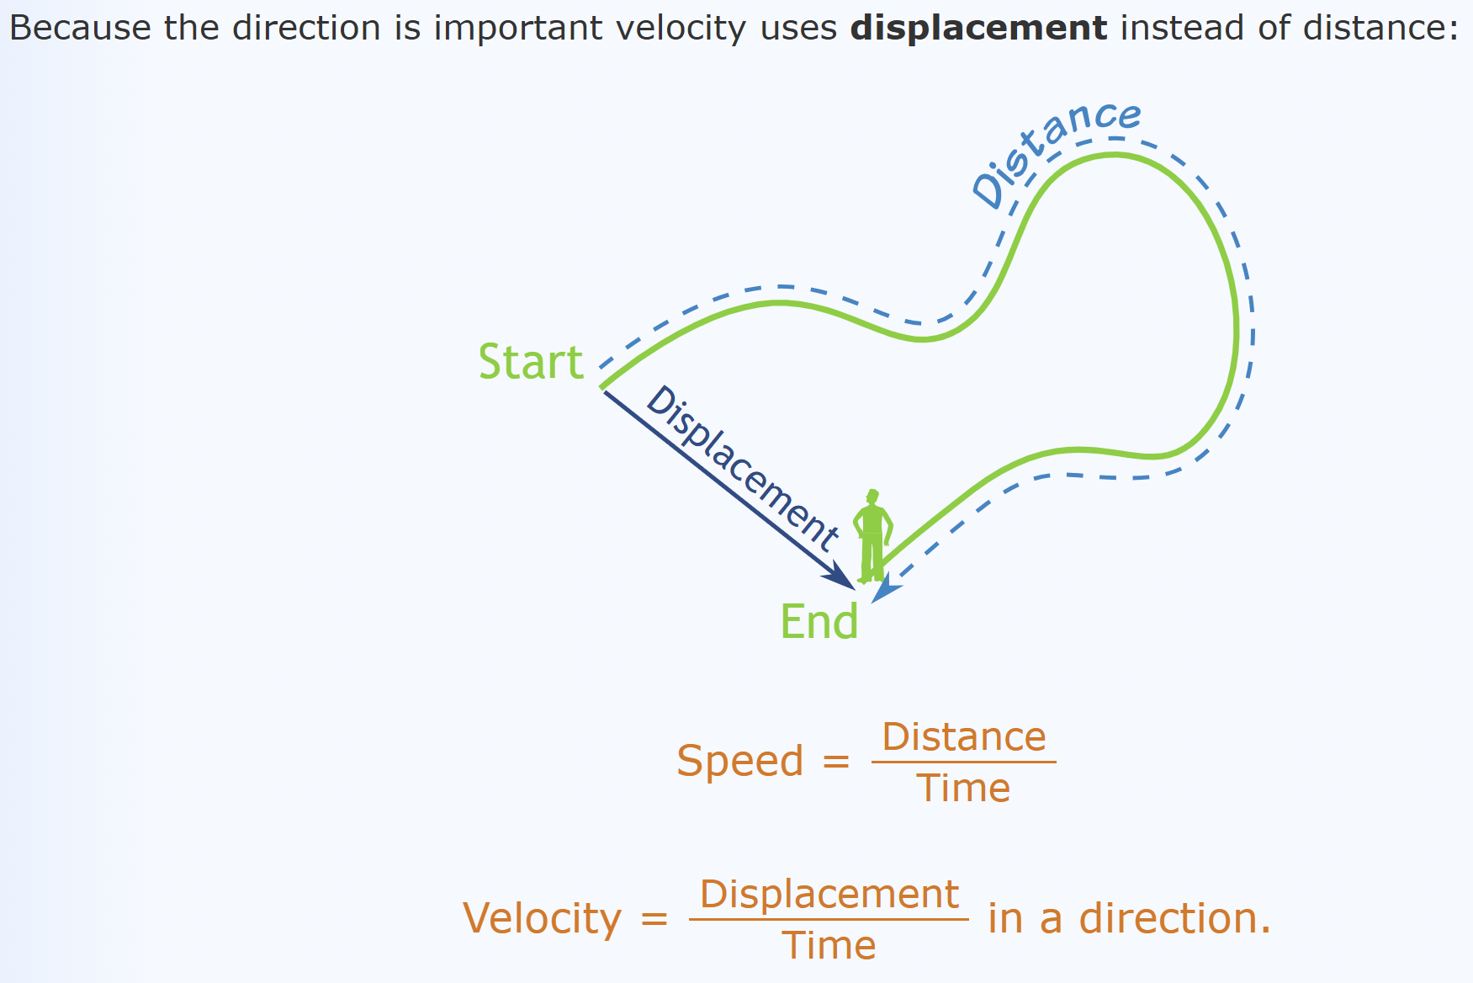

Slide 15
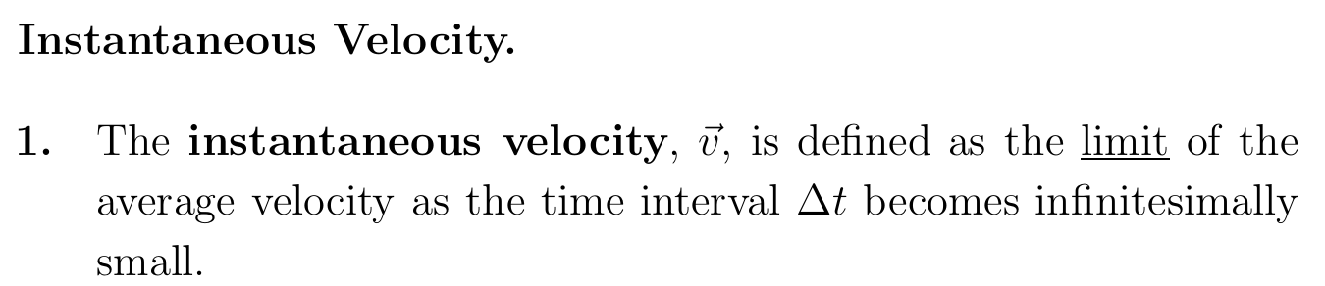
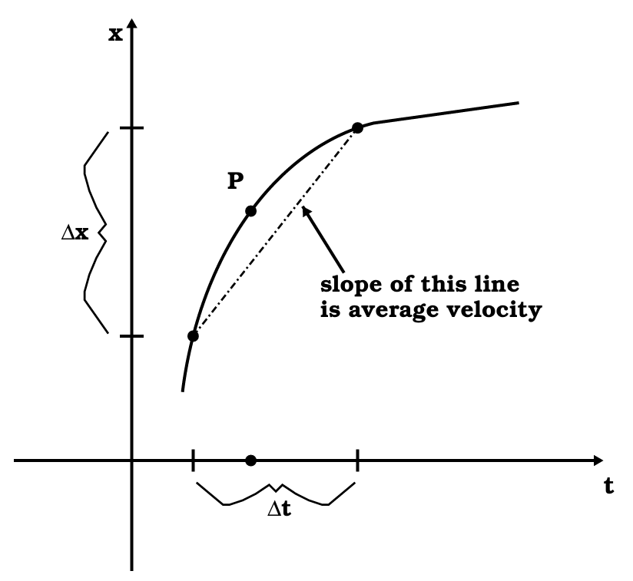
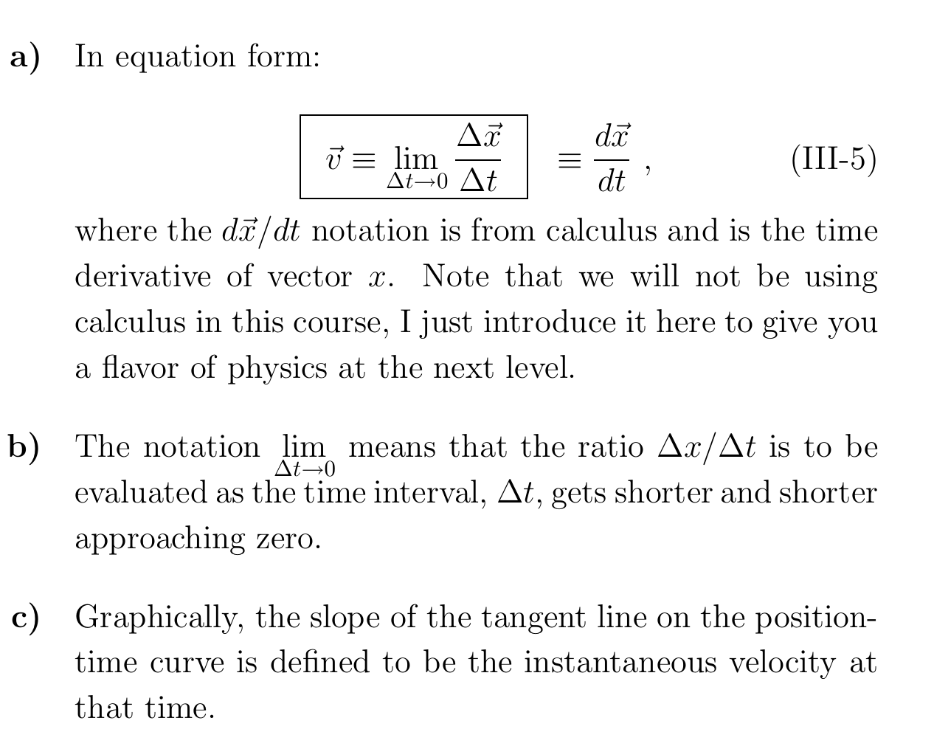

Slide 16
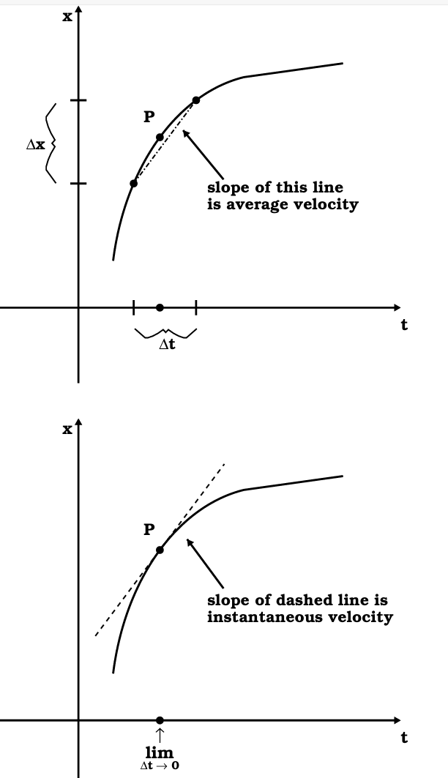
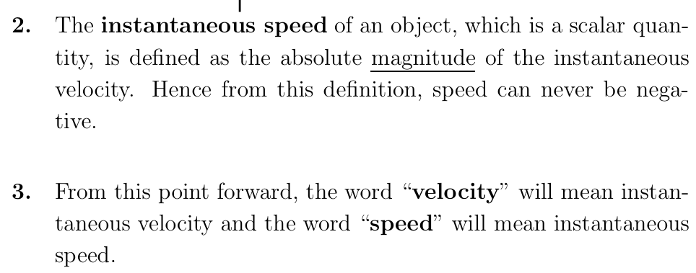

Slide 17
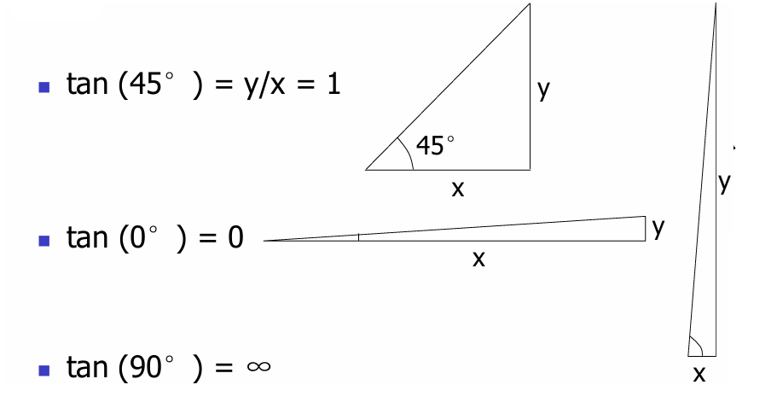
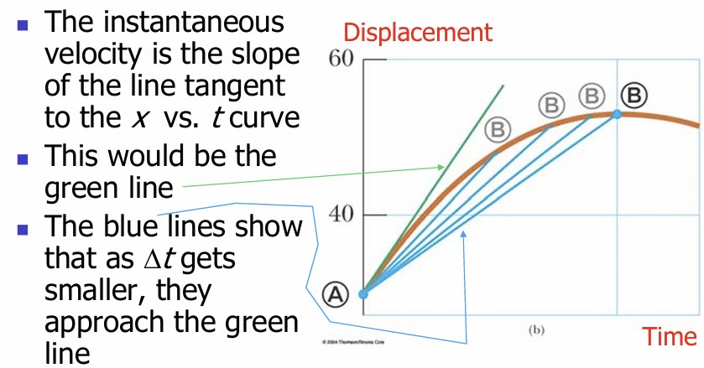

Slide 18
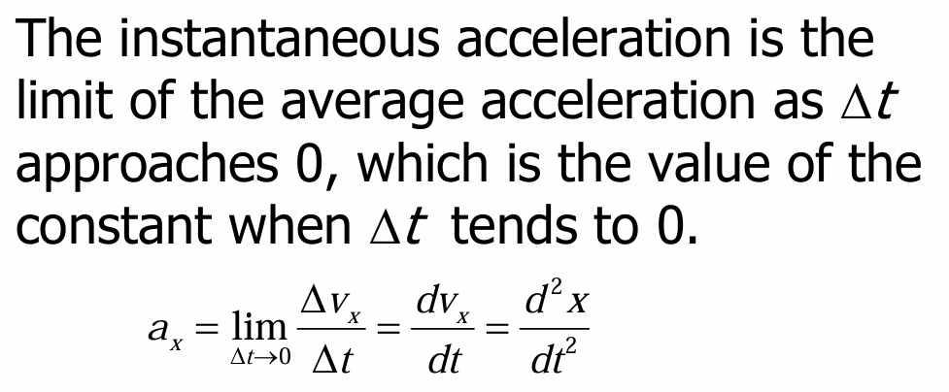
Instantaneous Acceleration

Slide 19
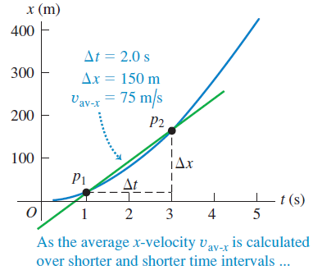
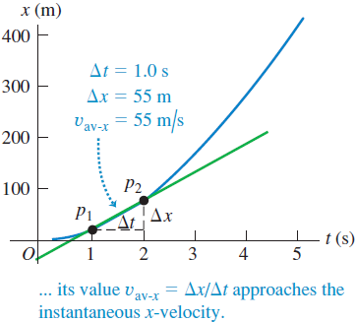
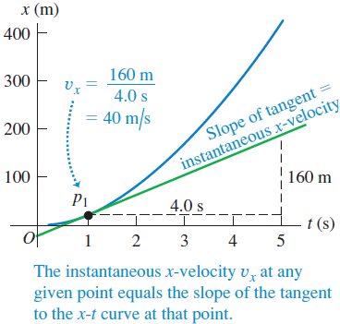
Instantaneous Velocity Sketched

Slide 20

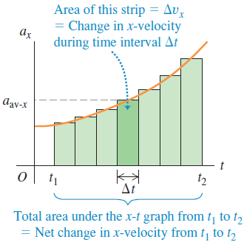


Velocity and Position by Integration
For each Δt
In the limit when Δt becomes small, the area under the a_{x}t curve is the integral of a_{x} (which is in general a function of t)
Similarly, for displacement

Slide 21
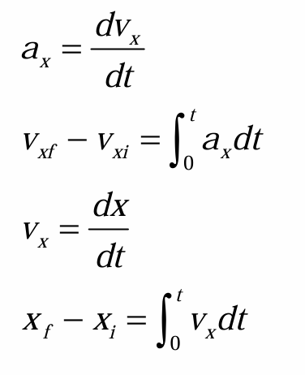
Kinematic Equations –General Calculus Form
If t₁ = 0 and t₂ is any later time t, and if x and v are the position and velocity, respectively, at time t = 0

Slide 22
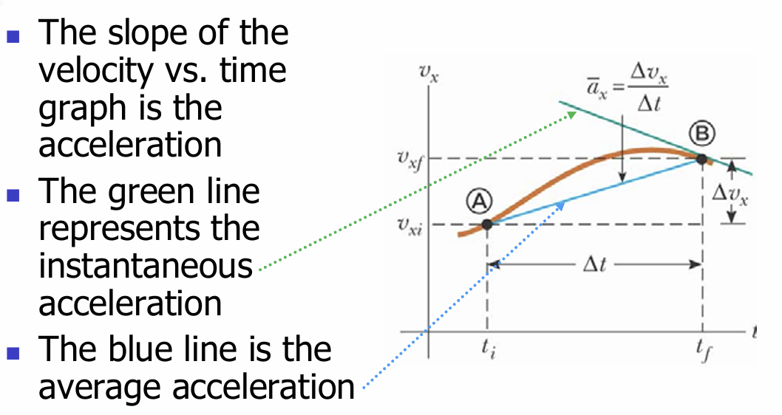
Instantaneous Acceleration graph

Slide 23

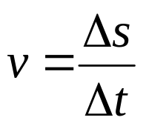
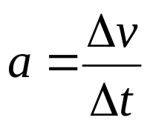
Describing Motion Again (Motion graph)
Another efficient way to describe motion is by graphs.
Moving to the right with the same speed of 3 meters per second.
s(m)
v(ms⁻¹)
a(ms⁻²)
12
12
12
9
9
9
6
6
6
3
3
3
0
t(s)
0
t(s)
0
t(s)
1
2
3
4
1
2
3
4
1
2
3
4
v is the slope of s-t graph & a is the slope of v-t graph.

Slide 24
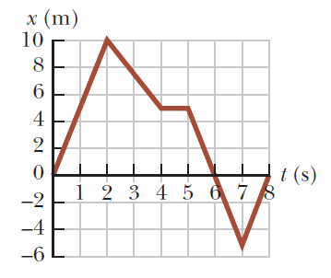
Describing Motion Again (Motion graph)
Exercise
Plot the v-t and a-t graphs for the following s-t graph.

Slide 25
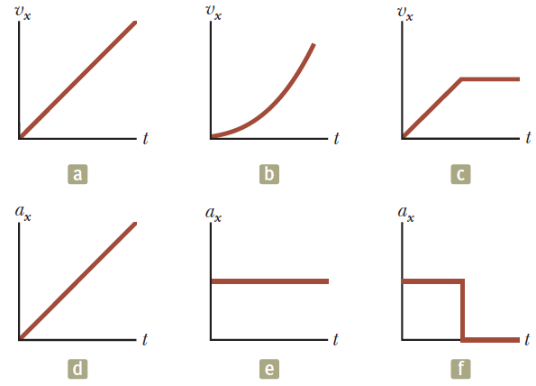
Relations between velocity and acceleration: Quick Test
Match each v_{x}–t graph on the top with the a_{x}–t graph on the bottom that best describes the motion.

Slide 26
Describing Motion Again (Motion graph)
Can we do it in a reverse way (from a-t => v-t => s-t)?
a(ms⁻²)
v(ms⁻¹)
s(m)
12
12
12
9
9
9
6
6
6
3
3
3
0
t(s)
0
t(s)
0
t(s)
1
2
3
4
1
2
3
4
1
2
3
4
Δv is the area under curve of a-t graph &
Δ s is the area under curve of v-t graph.

Slide 27
Describing Motion Again (Motion graph)
An interesting case is an object with constant acceleration.
a(ms⁻²)
v(ms⁻¹)
s(m)
12
12
12
9
9
9
6
6
6
3
3
3
0
t(s)
0
t(s)
0
t(s)
1
2
3
4
1
2
3
4
1
2
3
4
Δ v is the area under curve of a-t graph &
Δ s is the area under curve of v-t graph.

Slide 28
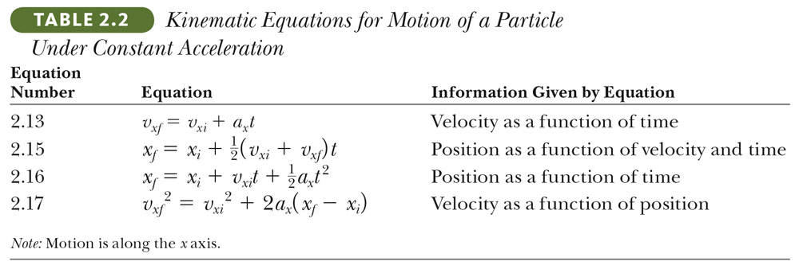
Describing Motion by Kinematic Equations
To describe motion, we actually want to specify and predict the displacement (s), velocity (v) and acceleration (a) at some particular time (t).
In technical language, we want to write down the equations of s, v, a as a function of t.
We want to derive kinematic equations which can be used with any particle under uniform (constant) acceleration.

Slide 29
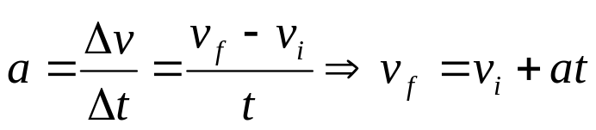
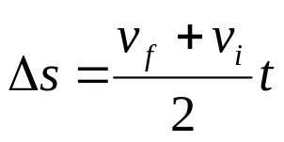
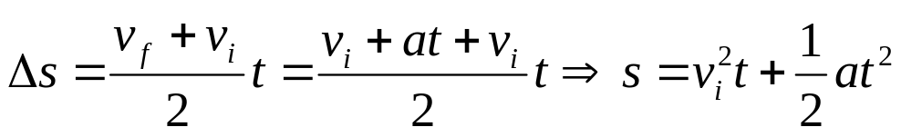
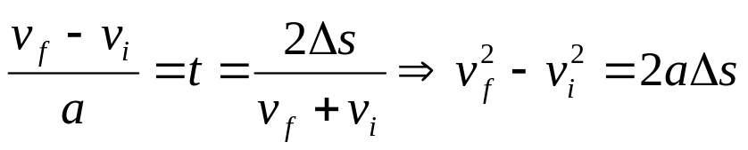
Derivation of Kinematic Equations
From the definition of acceleration,
--- Eq (1)
v(ms⁻¹)
v_{f}
Δ s is the area under curve of v-t graph,
--- Eq (2)
v_{i}
Combining Eq (1) & Eq (2),
0
t(s)
1
2
3
4
--- Eq (3)
--- Eq (4)

Slide 30
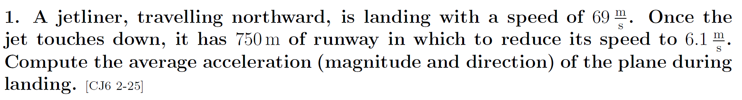
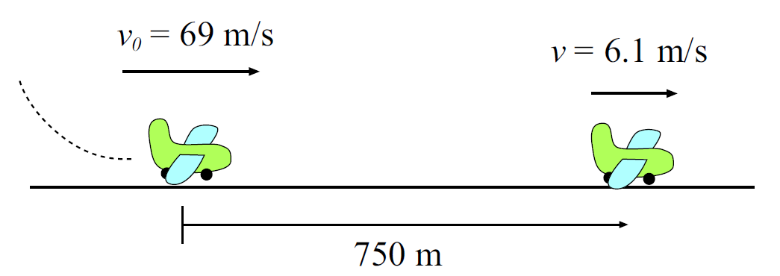
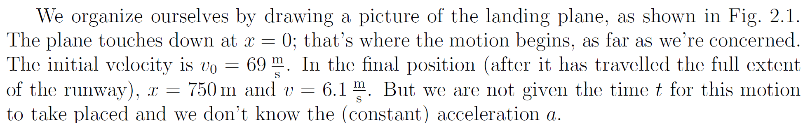

Slide 31
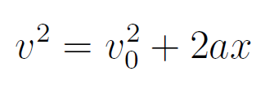
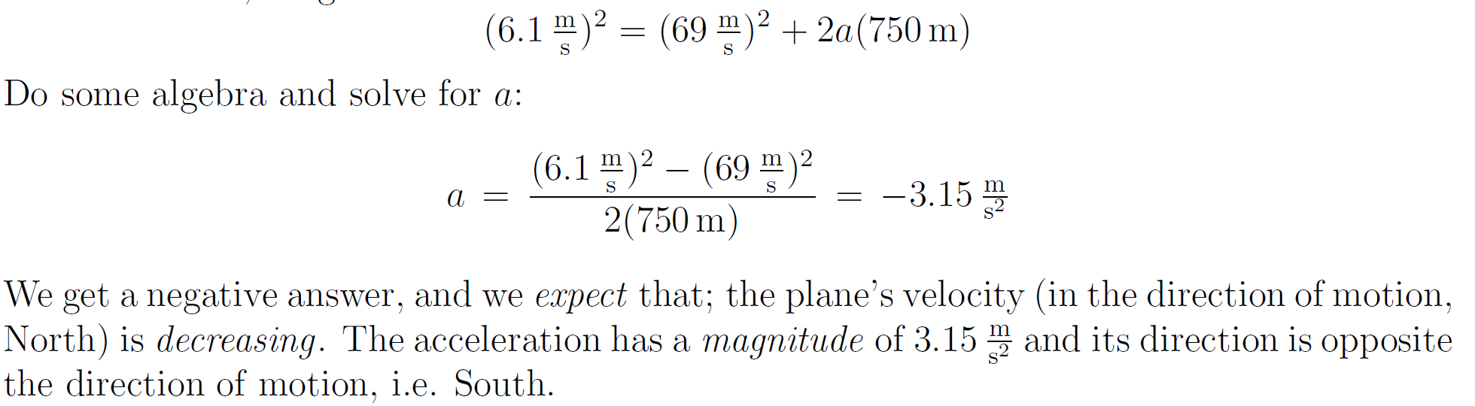

Slide 32
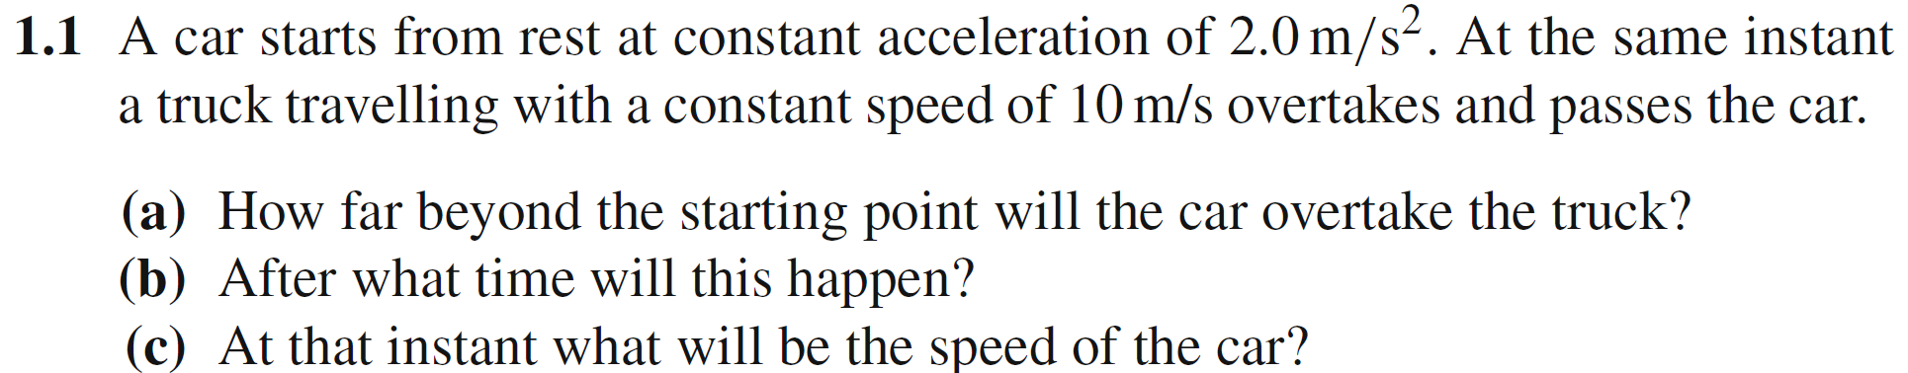

Slide 33
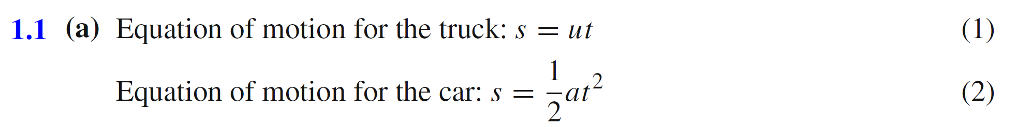
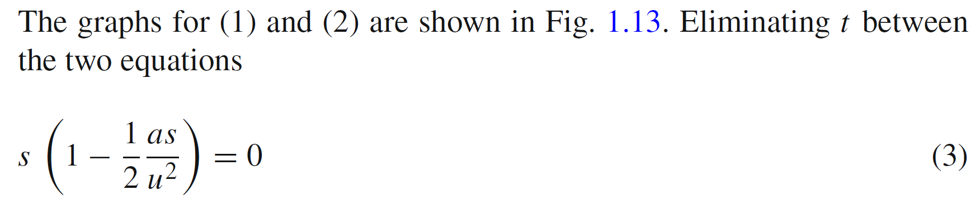
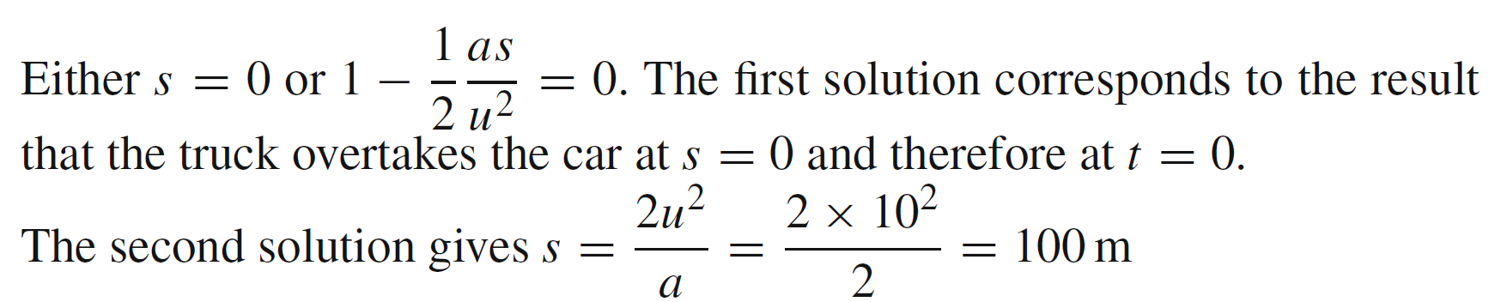
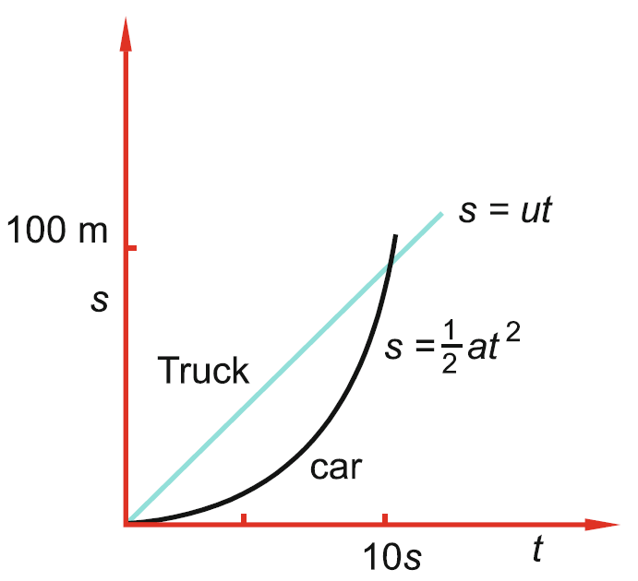
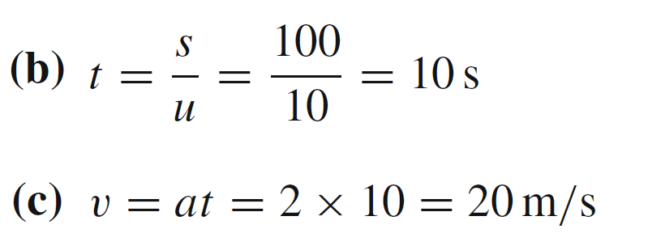

Slide 34
Review and Examples
Physics for Scientists and Engineers with Modern Physics, J.W. Jewett Jr. and R.A. Serway
Worked Examples from Introductory Physics Vol. I: Basic Mechanics, by David Murdock
1000 Solved Problems in Classical Physics, by Ahmad A. Kamal

